Slide 1
BUILDING A REAL ROBOT APP Sebastian Witalec @sebawita

Slide 2

The story from the community

Slide 3
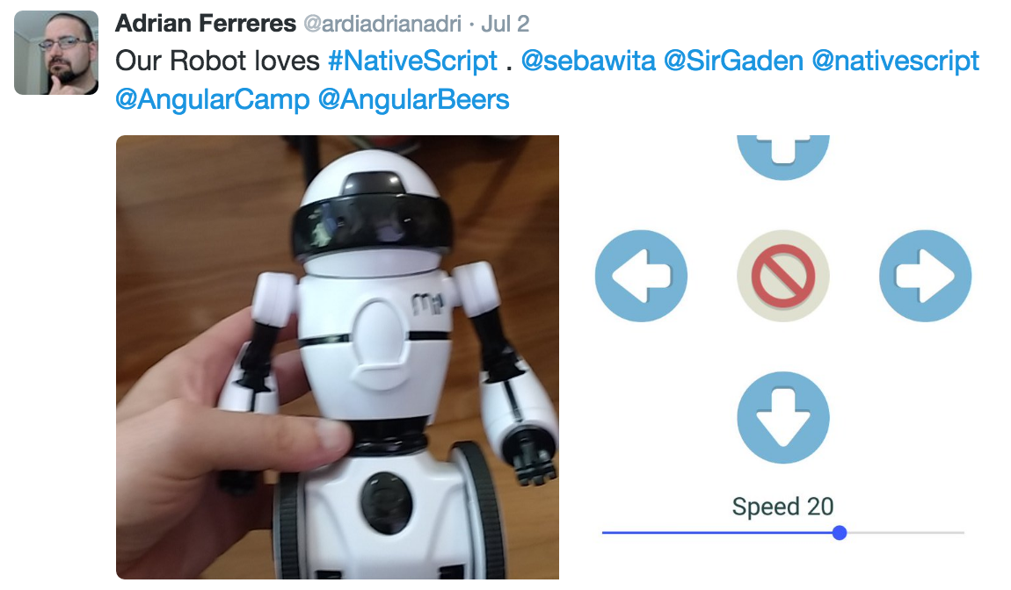
Inspired in Barcelona
Notes:
http://wowwee.com/mip

Slide 4
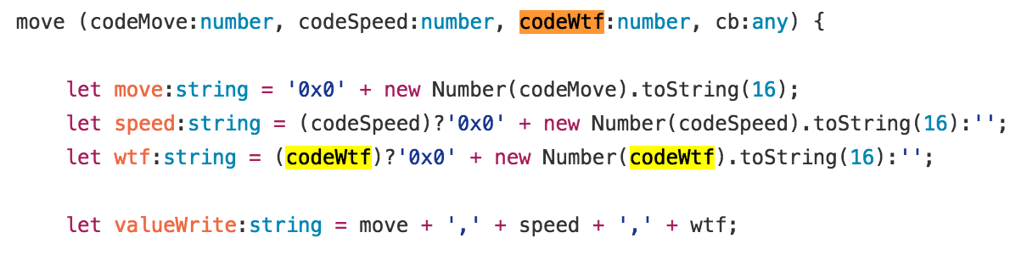
The problem

Slide 5
Level up

Slide 6
Bluetooth
Scan
Connect
Send Commands

Slide 7
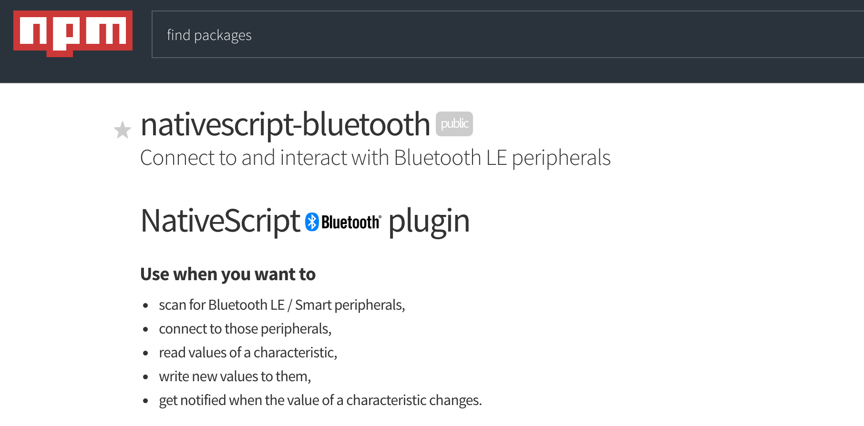
https://www.npmjs.com/package/nativescript-bluetooth

Slide 8

Sending commands Service / Characteristics

Slide 9
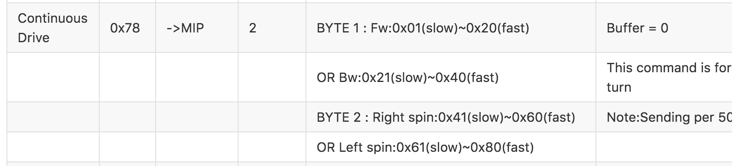
Sending commands Protocol
https://github.com/WowWeeLabs/MiP-BLE-Protocol/blob/master/MiP-Protocol.md

Slide 10
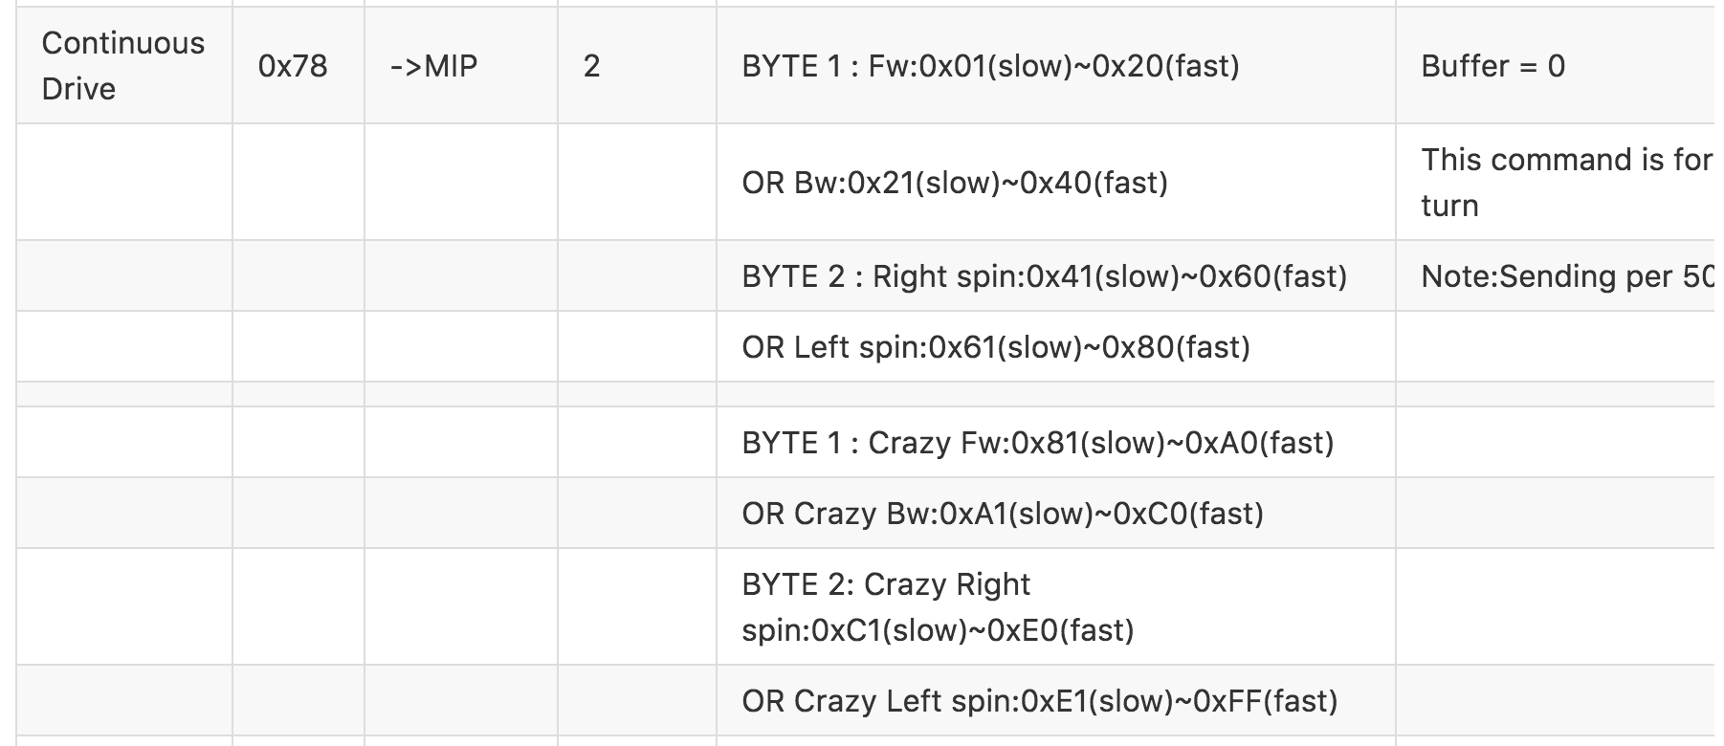
Sending commands Protocol
https://github.com/WowWeeLabs/MiP-BLE-Protocol/blob/master/MiP-Protocol.md

Slide 11
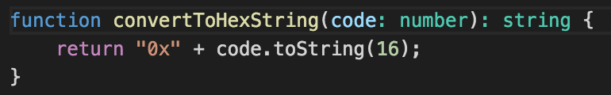
Sending commands WowWee Gotcha #1
Strange conversion to hex to string :s

Slide 12
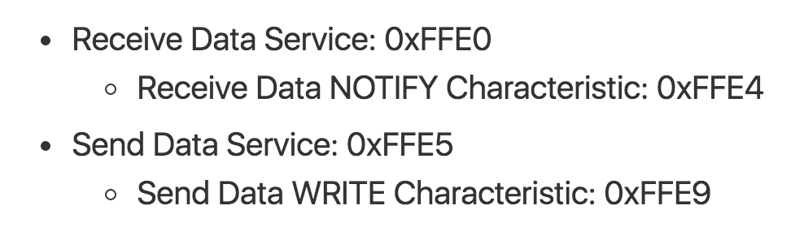
Reading data
Add Listener
(Receive DS)
Request Data
(Send DS)
onNotify

Slide 13
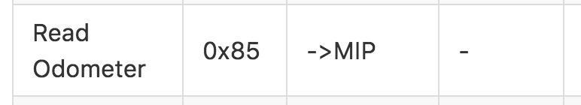
Reading commands Protocol

Slide 14
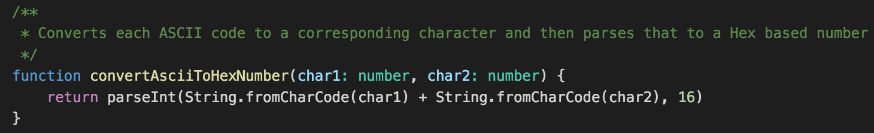
Reading data Gotcha #2 aka Are you for real?

Slide 15
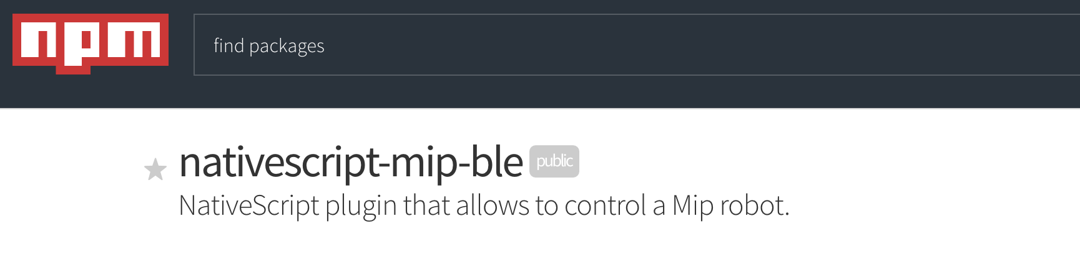
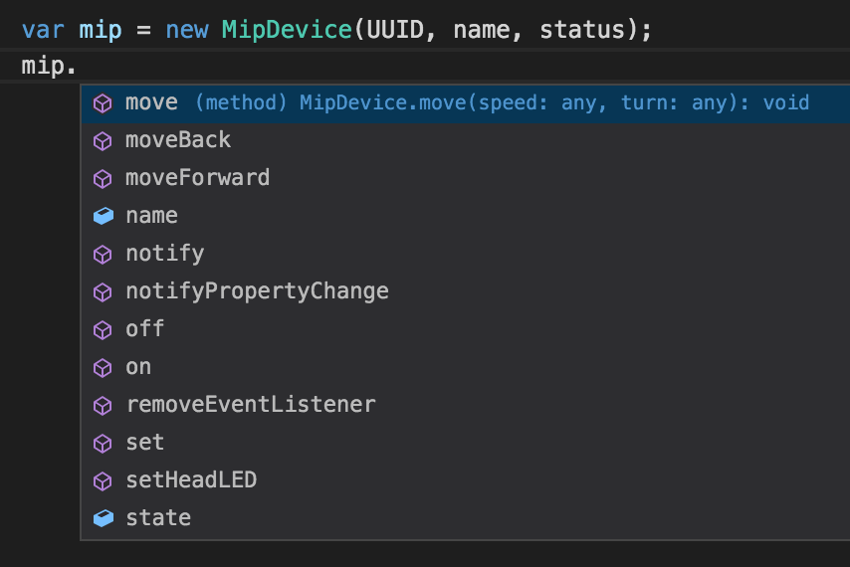
https://www.npmjs.com/package/nativescript-mip-ble

Slide 16

Show me the code

Slide 17
V2 - Native SDK

Slide 18
Taking it a step further
Notes:
http://wowwee.com/robosapien-blue

